Slide 1
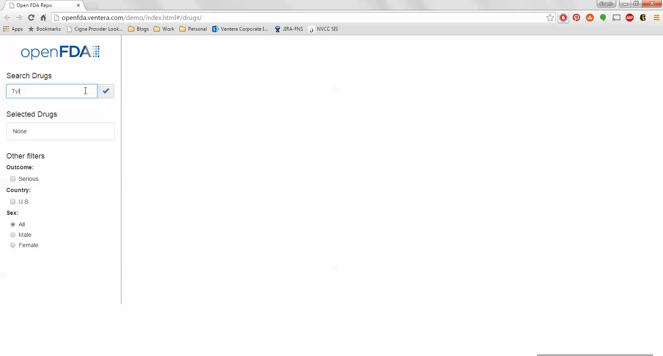
Exhibit 3.3: Working Prototype 1

Slide 2
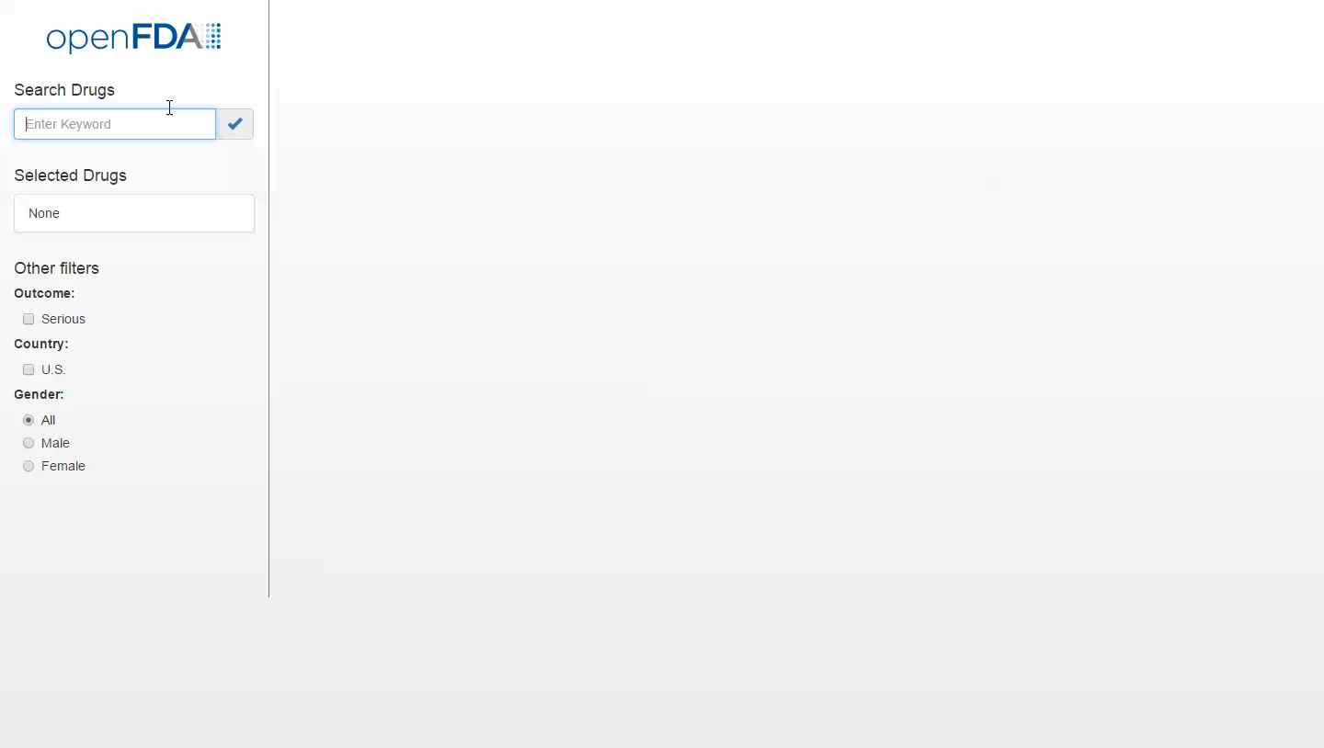
Exhibit 3.4: Working Prototype 2 (Post-Survey)

